Slide 1
Expense Master
Mohd Tabish khan and vimal pandey
20231010115006 , 202310101150005,
Btech cs (ds+AI) 1st year, b1601.

Slide 2
Expense Master
Introduction of team member/members.
Tabish and Vimal are 1st year students of B.tech CS (DS+AI). Tabish was responsible to design and produce the GUI of the project and also make the utility calculator app and merging all the different parts of the app together in Tkinter. Vimal has made the authentication and has handled the backend of the using firebase.
Technologies used .
Figma – to illustrate the GUI
Tkinter – Actually creating the GUI of the app .
Firebase – backend and authentication
Why this project? Project explanation.
Your expense tracking manager built in Python incorporates a Firebase backend, leveraging its authentication system to offer a secure and seamless experience for users. The Firebase integration enables functionalities like a login page and a signup page, ensuring that users can create accounts and securely access their personalized expense tracking profiles. Additionally, as a utility feature, the application includes a calculator, enhancing its usability by allowing users to perform quick calculations related to their expenses. This multifaceted approach not only ensures secure access but also enhances user experience by offering a versatile toolset within the expense tracking manager, making it more efficient and user-friendly.
Project implementation (Few Screen shots of project). – The first picture and the second picture is of Login and Sign Up page. The third picture is of the out main expense tracking app and the fourth is of a utility feature , a calculator.

Slide 3
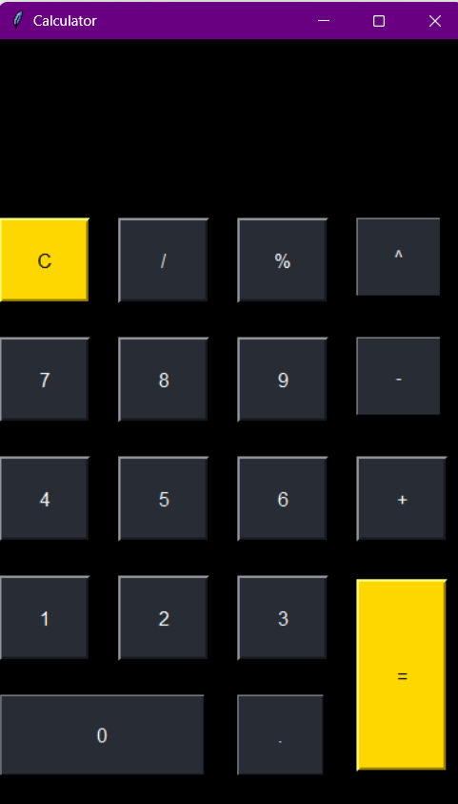
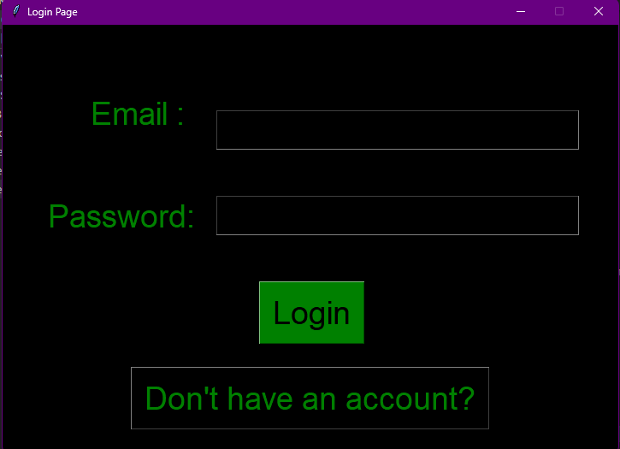
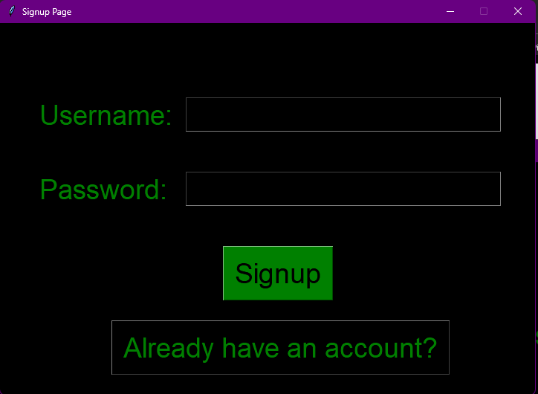
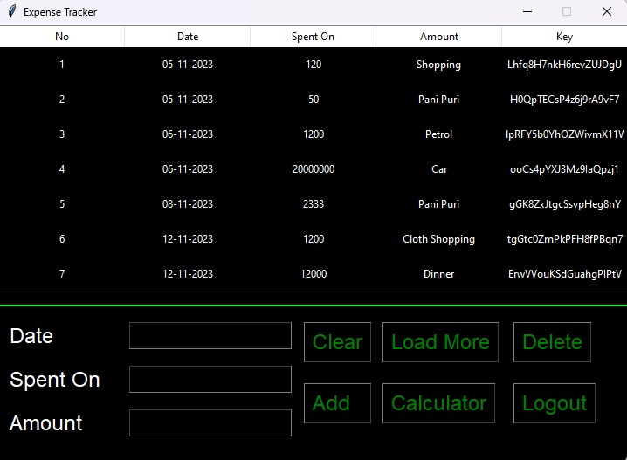

Slide 4
Expense Master
How can we utilize or how can we make this project useful in our daily life?
Offices:
Expense Monitoring: Employees can track their business-related expenses, submit reimbursement requests, and manage their spending within company guidelines.
Budget Management: Departments or teams can maintain and monitor their budgets, enabling better financial planning and control.
Financial Reporting: Generate expense reports effortlessly, facilitating easier accounting and financial analysis for management.
Schools:
Budget Tracking for Departments: Schools can manage and track budgets for different departments like academics, sports, extracurricular activities, etc.
Student Reimbursements: Teachers or staff can track and process reimbursements for student-related expenses like field trips, educational materials, etc.
Financial Accountability: Transparent tracking of school expenses can ensure that funds are used appropriately and transparently.
Personal Use:
Personal Expense Tracking: Individuals can monitor their daily expenses, set budgets, and analyze spending habits for better financial management.
Shared Expenses: Roommates or family members can track shared expenses, making it easier to split costs and manage shared finances.
In all these scenarios, the Firebase-integrated expense tracking manager provides a secure platform for managing expenses, creating accounts securely, and using a calculator for quick calculations, thereby facilitating efficient expense management and financial planning.

